Slide 1


.NET MAUI Part 3: Navigation
James Montemagno
Principal Lead PM – Developer Community, Microsoft
@JamesMontemagno
/JamesMontemagno

Slide 2
.NET MAUI Part 3: Navigation
<Name>
<Role>
@<Twitter>
/<YouTube>

Slide 3
Basic Navigation
Root Page:
NavigationPage – Gives each page an INavigation
Standard Navigation
Navigation.PushAsync(page: nextPage);
Navigation.PopAsync();
Modal Navigation
Navigation.PushModalAsync(page: modalPage);
Navigation.PopModalAsync();

Slide 4
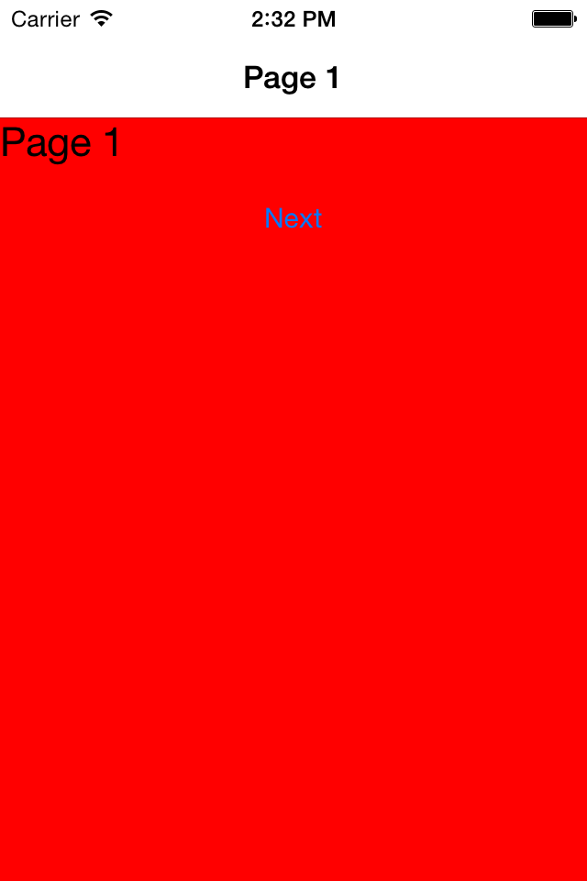
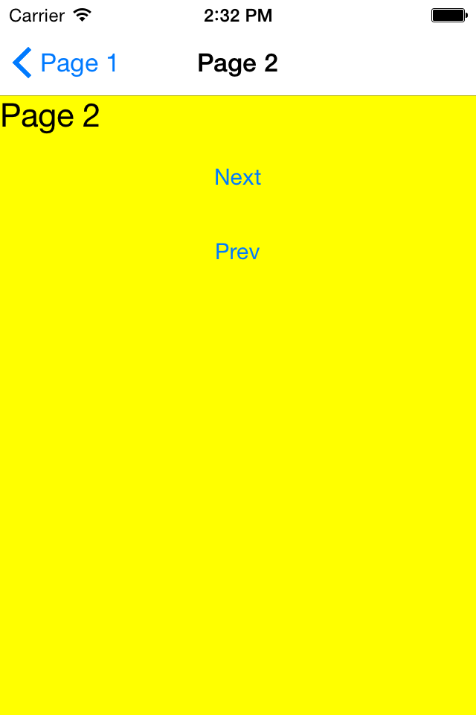
PushAsync/PopAsync

Slide 5
Advanced Navigation
Editing of stack beyond push/pop
Remove Page
InsertPageBefore
NavigationStack[]
Disable animations

Slide 6
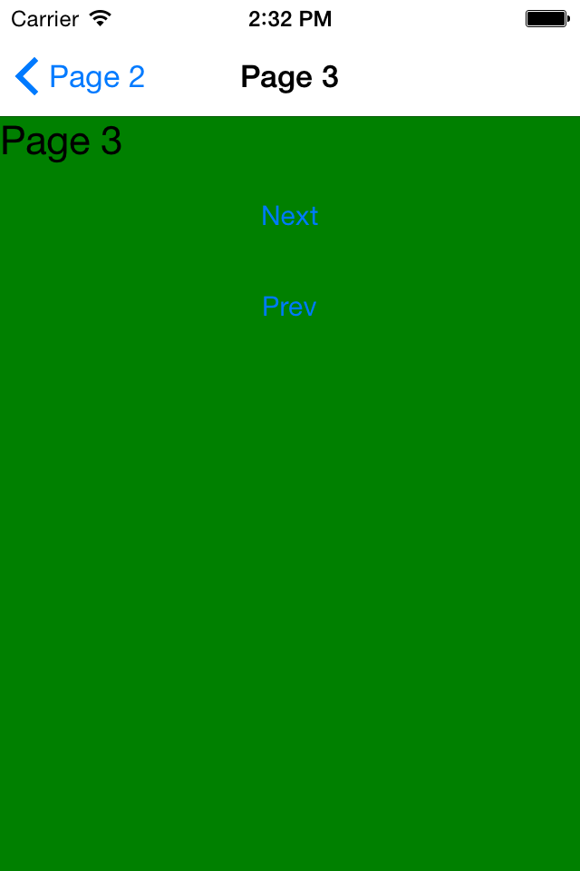
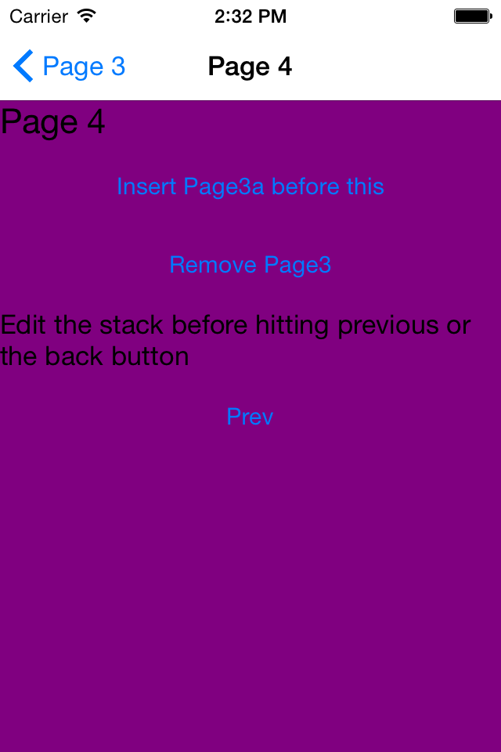
Push/Pop
RemovePage

Slide 7
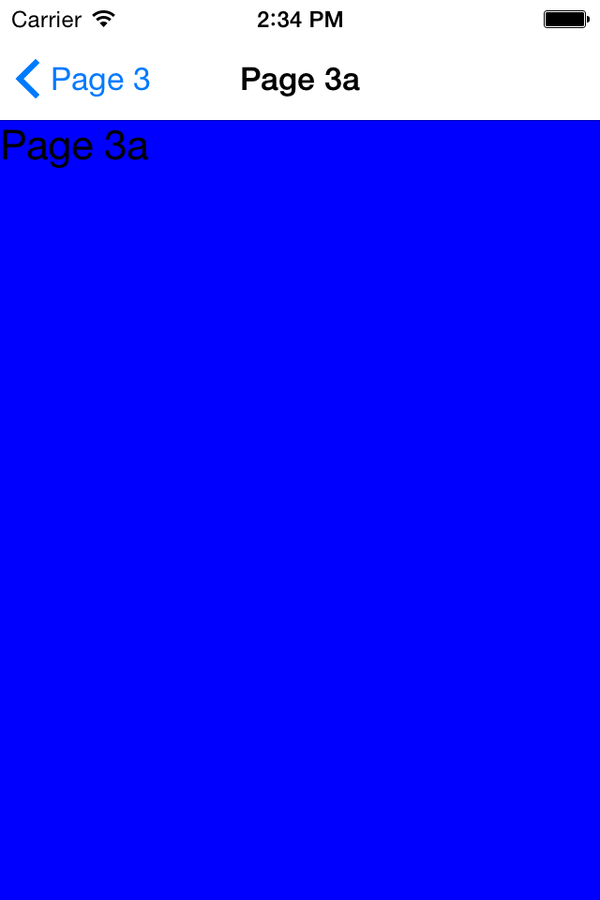
Push/Pop
InsertPageBefore

Slide 8
.NET MAUI Shell

Slide 9
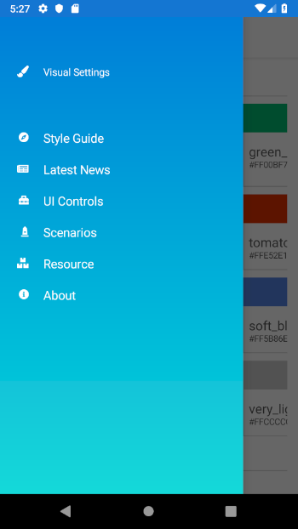
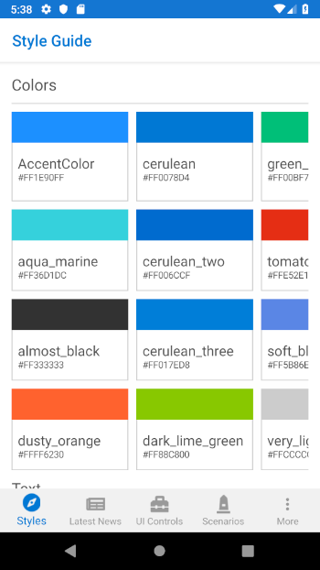
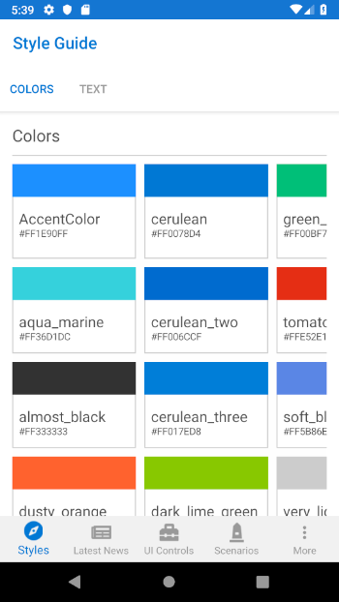
Shell

Slide 10
<Shell>
<FlyoutItem
Title="Style Guide"
Icon="Compass.png">
<ShellContent
ContentTemplate="{DataTemplate p:StyleGuidePage}"/>
</FlyoutItem>
</Shell>
Shell

Slide 11
<Shell>
<TabBar>
<Tab Title="Styles" Icon="Compass.png">
<ShellContent
ContentTemplate="{DataTemplate p:StyleGuidePage}"/>
</Tab>
</TabBar>
</Shell>
Shell

Slide 12
<Shell>
<TabBar>
<Tab
Title="Style Guide"
Icon="Compass.png">
<ShellContent
Title="Colors"
ContentTemplate="{DataTemplate p:ColorsPage}"/>
<ShellContent
Title="Text"
ContentTemplate="{DataTemplate p:TextPage}"/>
</Tab>
</TabBar>
</Shell>
Shell

Slide 13
CityListPage
CityDetailPage
Shell.Current.GoToAsync("detail");
Shell Navigation Service

Slide 14
CityListPage
CityDetailPage
Shell.Current.GoToAsync("..");
Shell Navigation Service

Slide 15
CityListPage
CityDetailPage
Shell.Current
.GoToAsync($"detail?id={city.id}");
Shell Navigation Service

Slide 16
CityListPage
CityDetailPage
[QueryProperty("CityId", "id")]
public partial class CityDetailPage : ContentPage
{
public CityDetailPage()
{
InitializeComponent();
}
public string CityId
{
set
{
// do something with the Id
}
}
}
Shell Navigation Service

Slide 17
CityListPage
CityDetailPage
var city = new City("Cleveland");
Shell.Current.GoToAsync("detail",
new Dictionary<string, object>
{
{"City", city}
});
Shell Navigation Service – Pass Objects

Slide 18
CityListPage
CityDetailPage
[QueryProperty("City", "City")]
public partial class CityDetailPage : ContentPage
{
public CityDetailPage()
{
InitializeComponent();
}
public City City
{
get; set;
}
}
Shell Navigation Service – Pass Objects

Slide 19
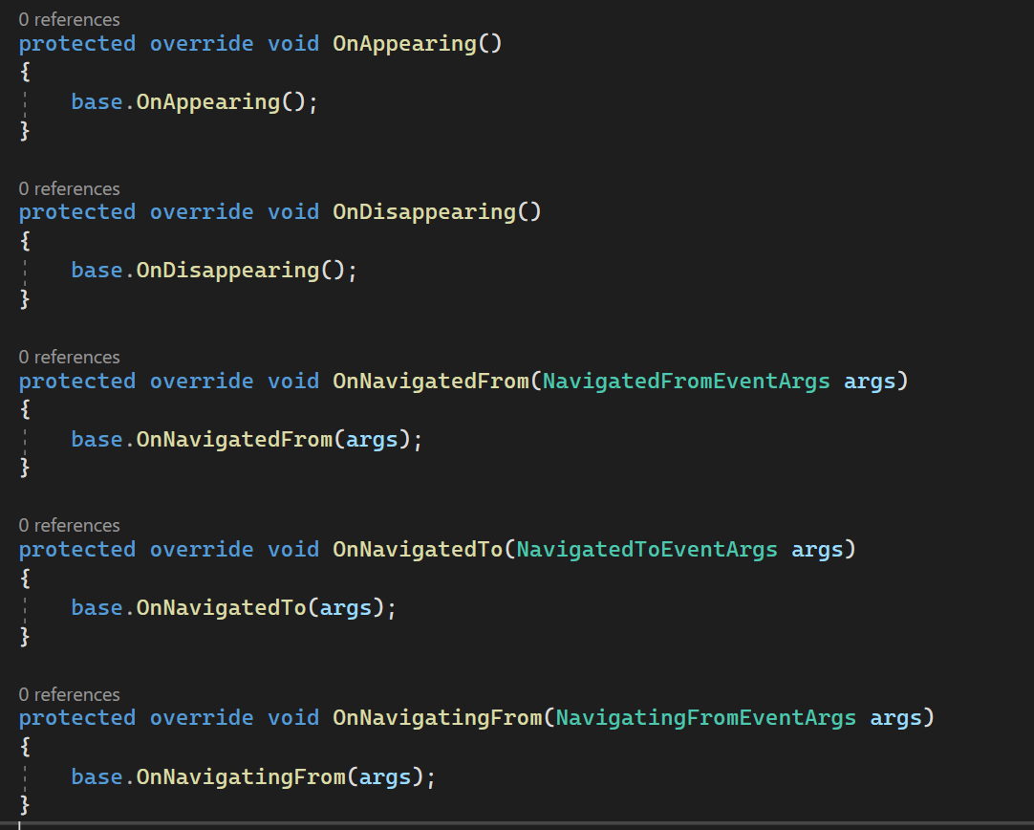

.NET MAUI Page Lifecycle
Legacy Page lifecycle events:
OnAppearing
OnDisappearing
Modern Navigation lifecycle events:
OnNavigatedTo
OnNavigatingFrom
OnNavigatedFrom

Slide 20
Let’s Navigate
<Name>
<Title>
<email>
<website>
@<twitter>
/<YouTube>

Slide 21

Let’s Navigate
Weekly development podcast
mergeconflict.fm
James
Montemagno
Principal Lead PM – Developer Community, Microsoft
motz@microsoft.com
montemagno.com
@JamesMontemagno
/JamesMontemagno

